Slide 1
CSE 2451 Pointers
Zichen Zhang

Slide 2
Overview
Program address space
Pointer to object
syntax
Return multiple values from a function
Implement passing by reference
Implement optional types
Pointer to pointer (double pointer)
Pointer to function
Syntax
Implement callbacks
Clockwise/spiral rule
typedef with function pointer type
Notes:
https://en.cppreference.com/w/c/language/pointer

Slide 3
Pointer – program’s address space
Every (byte) location in a program’s memory space has an address
Byte is the finest addressable location
Typically, the address is expressed in hexadecimal (16-based) format
1 byte
0
1
2
3
4
5
6
7
. . .

Slide 4
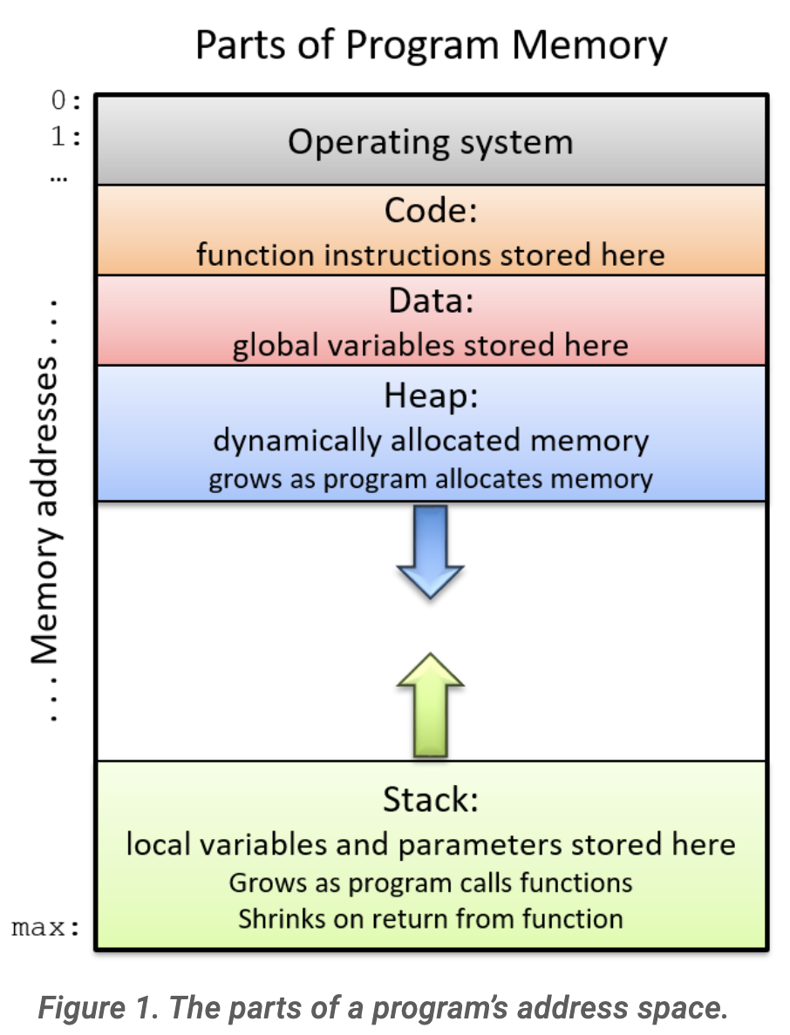
Pointer – program’s memory space
Variables are stored at some memory location
the stack segment (function scope, block scope)
the heap segment (file scope)
A memory location is identified with an address
Just like houses are identified with addresses
Pointer is a type of variable that stores address as its value
Image source: Suzanne J. Matthews, Tia Newhall, Kevin C. Webb, ”Dive into Systems”

Slide 5


Pointer to object
Object is referring to
Arithmetic types, pointer types, and arrays
Using * to declare a pointer to object
Using & (address-of operator) to fetch the address of an object
* is also an operator (dereference operator), it gives you access to the memory address stored in the pointer: to read from the address or to write to the address
type *identifier;

Slide 6
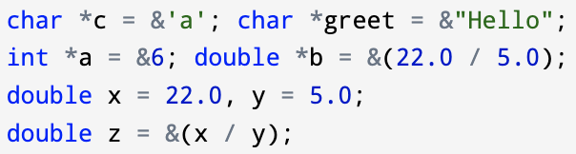

pointer – example
Two styles of declaring pointers
The first style is preferred, the second style is error-prone
Address-of operator can not be used on literals or expressions with operators
Wrong usage:
Correct usage:
*
*

Slide 7
Pointer – example
Visualization of pointer, and the pointed variable in memory space
Assuming we are using a 64-bit machine:
64-bit machine → sizeof(pointer) is 8 bytes
Assuming the size of int variable is 32 bits
sizeof(int) is 4 bytes
int data;
int *ptr = &data;
*ptr = 1;
Reserves memory to store an integer
Memory
316
320
324
328
332
data

Slide 8
Pointer – example
Visualization of pointer, and the pointed variable in memory space
int data;
int *ptr = &data;
*ptr = 1;
Reserves memory to store a pointer
Memory
316
320
324
328
332
data
ptr
4 bytes
8 bytes

Slide 9
Pointer – example
Visualization of pointer, and the pointed variable in memory space
int data;
int *ptr = &data;
*ptr = 1;
stores the starting byte address (316) of data into the pointer
Memory
316
320
324
328
332
316
data
ptr

Slide 10
Pointer – example
Visualization of pointer, and the pointed variable in memory space
int data;
int *ptr = &data;
*ptr = 1;
get the address stored in ptr, go to the address
Memory
316
320
324
328
332
316
data
ptr

Slide 11
Pointer – example
Visualization of pointer, and the pointed variable in memory space
int data;
int *ptr = &data;
*ptr = 1;
Writes 1 to that memory address
Memory
316
320
324
328
332
1
316
data
ptr

Slide 12
Pointer – example
Why do we need to specify the type of object pointed by a pointer?
Type of the pointer is used to tell the dereference operator:
how many bytes of memory to access
the format of decoding/encoding used to read/write the memory block
int data;
int *ptr = &data;
*ptr = 1;
Writes the data to that memory
Memory
316
320
324
328
332
1
316
data
ptr

Slide 13
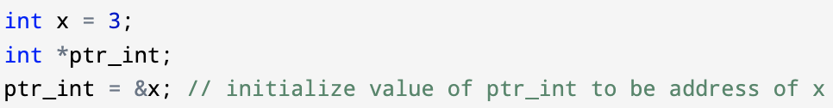
Pointer – initialization
Initialization at declaration of the pointer
Initialization after declaration of the pointer
read the value of x via pointer
points to the address of x
dereference to
read value of x

Slide 14
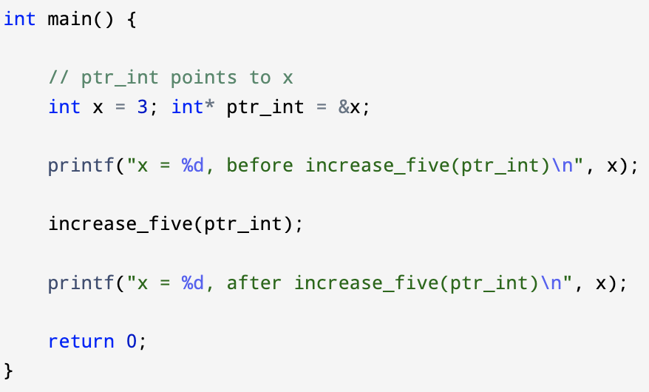
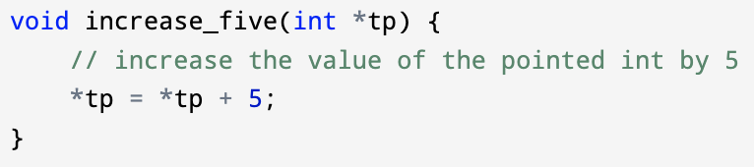

Pointer – As input arguments of a function
This is still passing by value (the address) from the pointer’s perspective, but it achieves passing by reference from the perspective of the pointed object (whose address is being passed to the function)

Slide 15
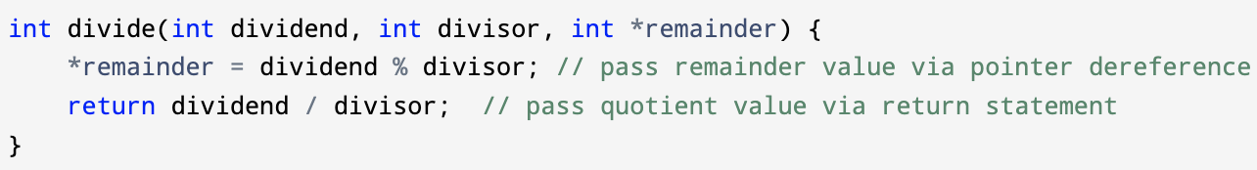
Pointer – function with multiple return values
Use pointer as input arguments to “carry extra values” out of the function
In the above example, the (remainder) pointer input argument takes the address of some object in the caller’s scope, changes made to the content stored in this address will last after the function call ends
This function returns two values
Value of dividend % divisor stored in *remainder
Value of dividend / divisor returned with the return statement

Slide 16
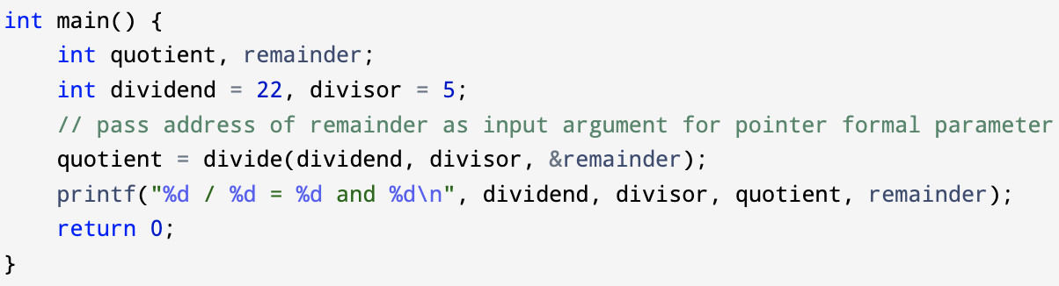

Pointer – function with multiple return values
Use pointer as input arguments to “carry extra values” out of the function

Slide 17
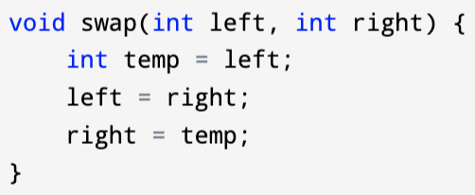
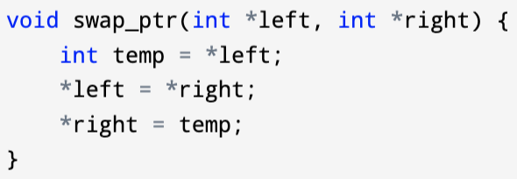
Pointer – example
We can use pointer to implement “passing by reference” for the pointed objects
wrong implementation:
Left and right are copies of the original inputs’ values, swapping copies won’t work
correct implementation:
Left and right are copies of the original inputs’ memory addresses, swapping values stored in these addresses will work

Slide 18
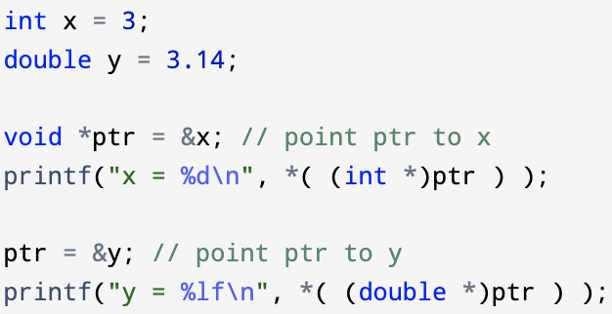

Pointer – void pointer
void pointer in C is a pointer not associated with any specific data types, sometimes void pointers are referred as generic pointers
Pointer arithmetic is illegal on void pointers
Dereference operator can’t be applied to void pointers (since there’s no type information)
We can use type conversion operator to convert void pointer to other type of pointers, then apply other operations accordingly

Slide 19
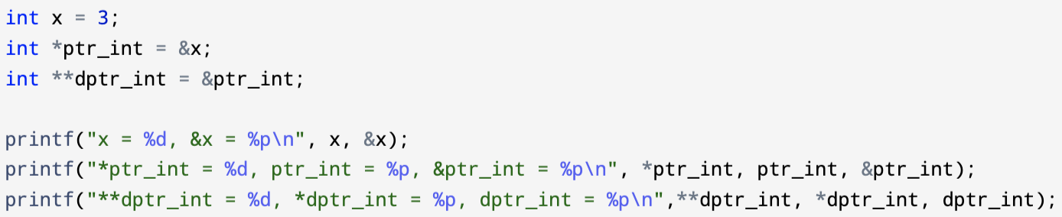
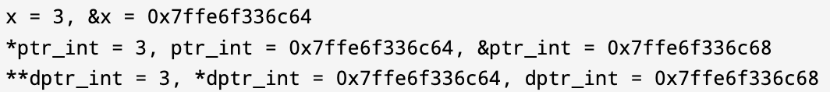
Pointer to pointer
A pointer “pointing to” a pointer, it stores the memory address of a pointer. Such a pointer to pointer is also referred as a double pointer
Format: type **identifier;
Specify the value to be printed is an address with %p

Slide 20
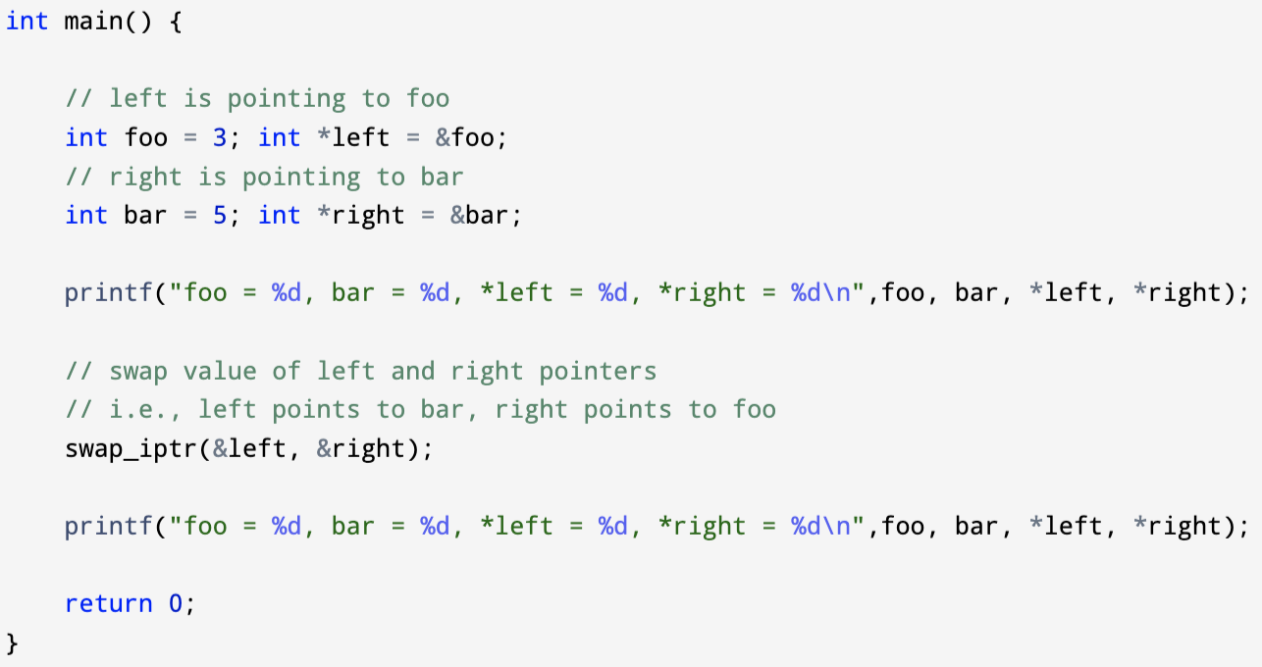
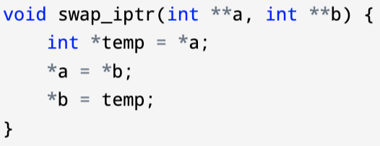

Double pointer – example
Just like swapping value of integer variables, now we want to swap value of pointers
Note: the value of foo and bar are not swapped, but now left is pointing to bar, and right is pointing to foo

Slide 21
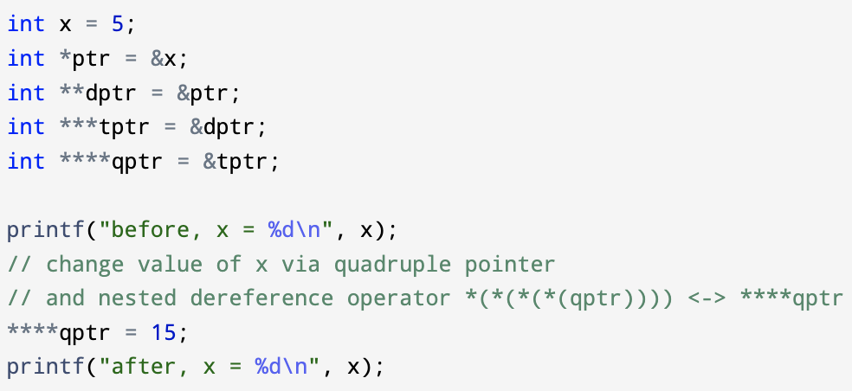

Pointer to pointer – example
There’s also triple and quadruple pointers in C…
Triple pointer, e.g., type ***identifier;
Quadruple pointer, e.g., type ****identifier;
They follow similar syntax as single pointer

Slide 22
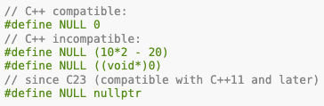
Pointer – NULL pointer constant
NULL is a constant defined with implementation-specified preprocessor directive:
Usually used:
As a function return value , indicates something wrong occurred
As an input to a function, when we don’t want to pass a valid address
Dereferencing a NULL valued pointer is undefined behavior
Check if a pointer == NULL before dereference it

Slide 23
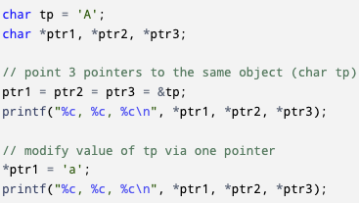

Pointer – Multiple Pointers
Multiple pointers point to the same object

Slide 24
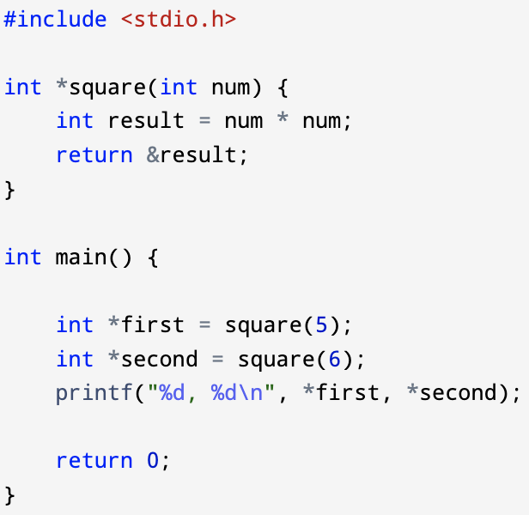
Pointer – In return statement
Functions returning a pointer
type *identifier(param-list);
int *foo(int);
double *bar(int, int);
char *ham(void);
void *spam(int *);
What’s the output of program?
Notes:
Segmentation fault
Result are function scope variable that’s temporarily saved in the stack segment, after function call, the associated stack frame is popped out of the stack

Slide 25
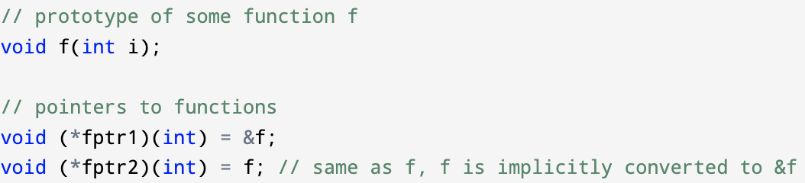
Pointer to function (function pointer)
A pointer to function can be initialized with an address of a function:
An address of a function is the memory address of the function in the code segment of the program’s memory space
Callback → If a reference of a function is passed to another function as an argument to call it, then it will be called as a callback function
In C, a callback function is a function that is called through a pointer to the function

Slide 26

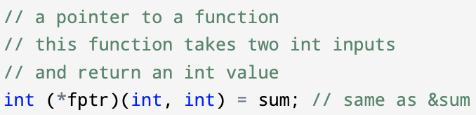
Pointer to function – example
Replace the original function identifier in its function prototype with a (*fptr) will lead to the declaration of an associated function pointer
The function to be pointed:
The pointer to the function:
int (*fptr)(int, int);
fptr = sum; //or fptr = &sum;

Slide 27
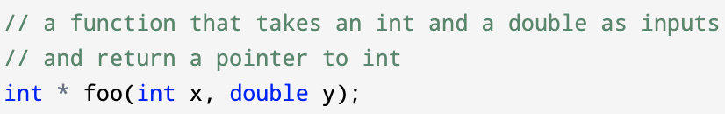
Pointer to function – example
Replace the original function identifier in its function prototype with a (*fptr) will lead to the declaration of an associated function pointer
The function to be pointed:
The declaration of a pointer to the function would be like?
Notes:
int * (*fptr)(int, double);

Slide 28
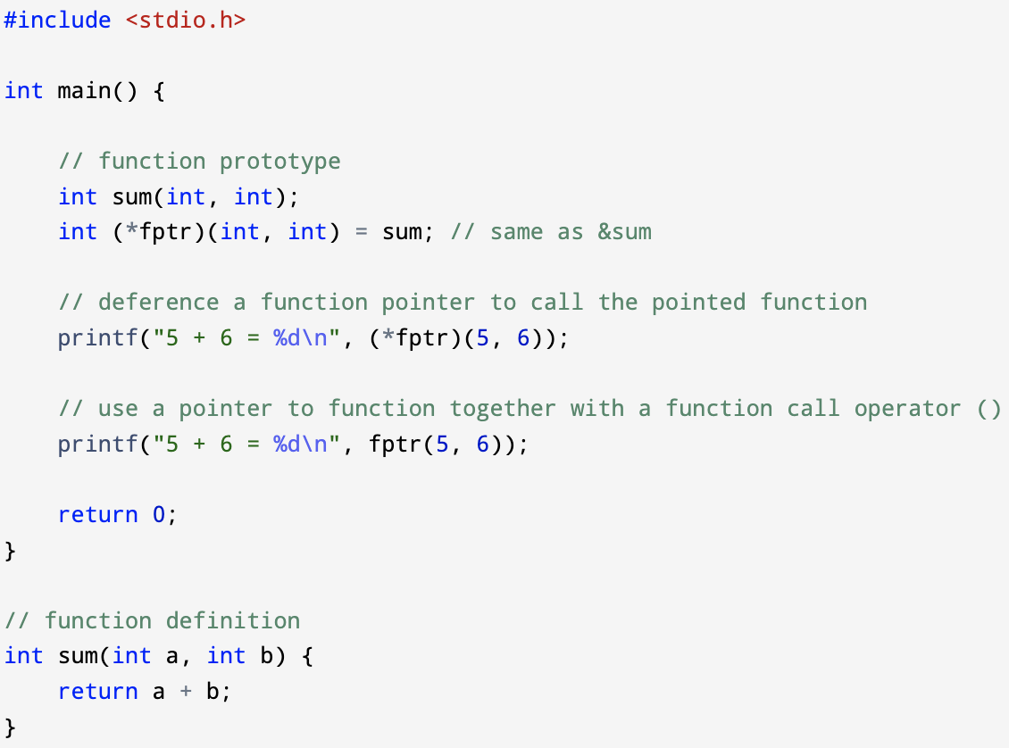
Pointer to function
Call a function through a pointer to the function can be done by
Deference the pointer to function
E.g., (*fptr)(5, 6)
Use the pointer to function directly with a function call operator
E.g., fptr(5,6)
Why do we want this?

Slide 29
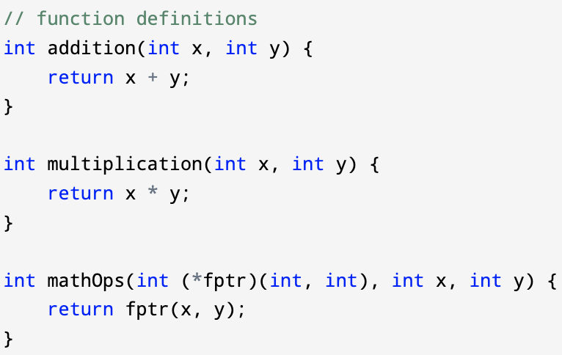
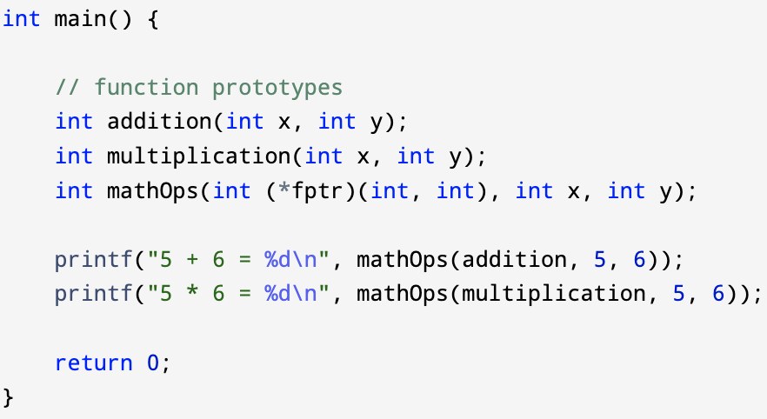
Pointer to function – example
Input arguments of a function can only be variables
A pointer to a function as the input argument of another function
returns a value
returns a value
returns a value

Slide 30
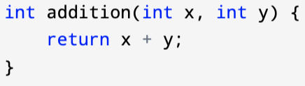
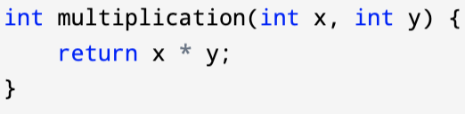

Pointer to function - example
A function pointer as the return value of another function
Instead of returning arithmetic typed objects, e.g., int, double
Or pointer to arithmetic typed objects, e.g., int *, double *
The function returns a function pointer
The target functions that my function pointer will point to:
The associated function pointer that my function will return:

Slide 31
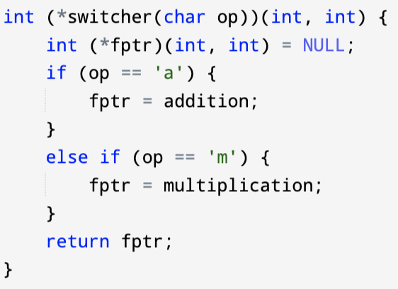

Pointer to function - example
A function pointer as the return value of another function
The function’s prototype type:
int (*switcher(char op))(int, int);
The function’s return type:
int (*switcher(char op))(int, int)
The function’s input parameter list:
int (*switcher(char op))(int, int)
The function call:
returns a function pointer

Slide 32


Pointer to function – Steps to write a function returning function pointer
Write the return function pointer’s declaration first
Replace the function pointer’s identifier with your function name
Insert the formal parameter list of your function after the function name

Slide 33


Pointer to function – nested function pointers
My function’s prototype:
A pointer to the above function: replace switcher with (*newfptr):
A pointer to a function pointer (‘double function pointer’): add one more *

Slide 34
Pointer to function – the clockwise/spiral rule
you can refer to the “clockwise/spiral rule (David Anderson, 1994)” to ‘decipher’ complex declaration of functions/function pointers
1. Starting with unknown element first, moving in a clockwise spiral direction, when encountering the following elements, replace them with the corresponding English statements
[X], or [] → Array X size of …, array undefined size of …
(type1, type2) → function passing type1 and type2 returning …
* → pointer(s) to // ** → double pointer to
2. Keep doing this in a spiral/clockwise direction until all tokens have been covered
3. Always resolve anything in parenthesis first

Slide 35
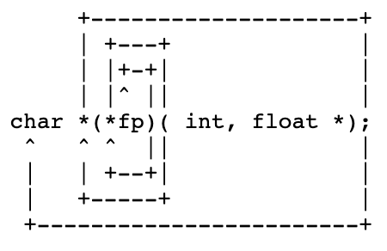
Pointer to function – the clockwise/spiral rule
a pointer to function
What’s fp?
// starts from fp, hits ‘)’, and ‘*’
fp is a pointer to …
// hits ‘( int, float *) ‘
fp is a pointer to a function passing an int and a float *, returning ...
// hits ‘*’
fp is a pointer to a function passing an int and a float *, returning a pointer to …
// hits ‘;’, and ‘char’
fp is a pointer to a function that takes in an int and a float *, returning a pointer to char

Slide 36
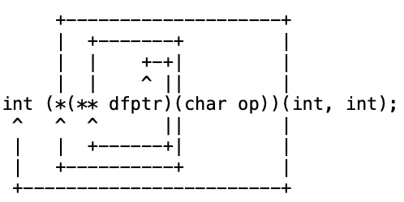
Pointer to function – the clockwise/spiral rule
a pointer to function
What’s dfptr?
// starts from dfptr, hits ‘)’, and ‘**’
dfptr is a double pointer to …
// hits ‘(char op) ‘
dfptr is a double pointer to a function passing a char, returning ...
// hits ‘*’
dfptr is a double pointer to a function passing a char, returning a pointer to …
// hits ‘(int, int)’
dfptr is a double pointer to a function passing a char, returning a pointer to a function passing two ints, returning …
// hits ’int’
dfptr is a double pointer to a function passing a char, returning a pointer to a function passing two ints, returning an int

Slide 37
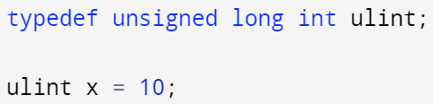
Pointer to function – use typedef
typedef allows us to define alternative names to types in C
typedef follows the standard scoping rule in C (belongs to ordinary identifier name space)
type
alias
Use defined type alias to declare a variable, equivalent to unsigned long int x = 10;

Slide 38
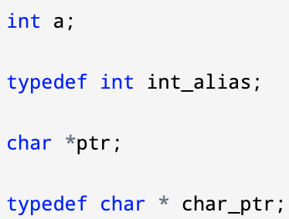
Pointer to function – use typedef
Declare an int variable:
Declare a type alias for int:
Declare a pointer to char variable:
Declare a type alias for char*

Slide 39
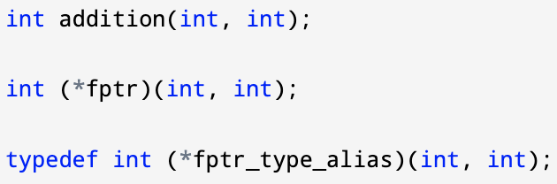
Pointer to function – use typedef
Declare a function
Declare a pointer to the function
Declare a type alias of the above function pointer’s type

Slide 40
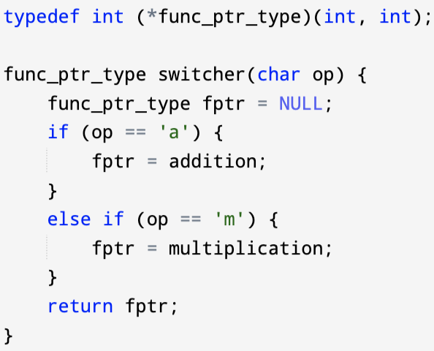
Pointer to function – use typedef
Define a type alias for the return function pointer’s type

